Slide 1
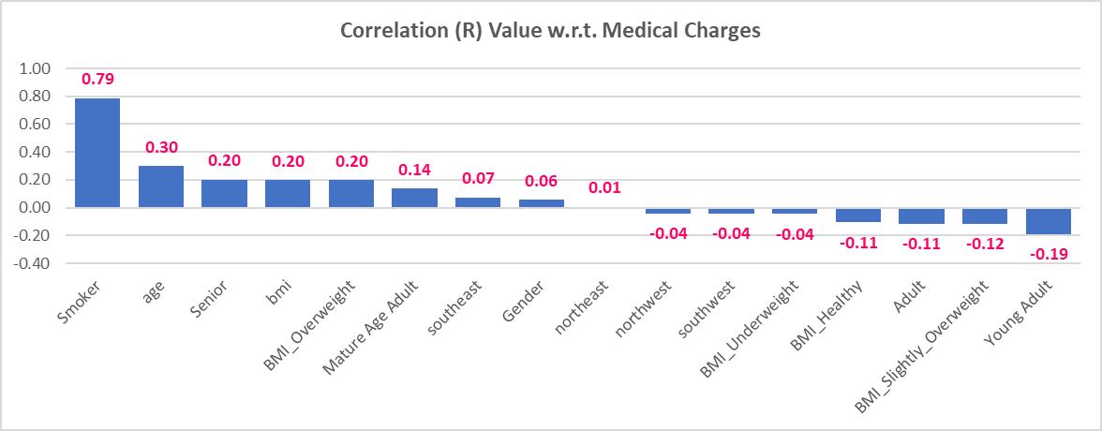
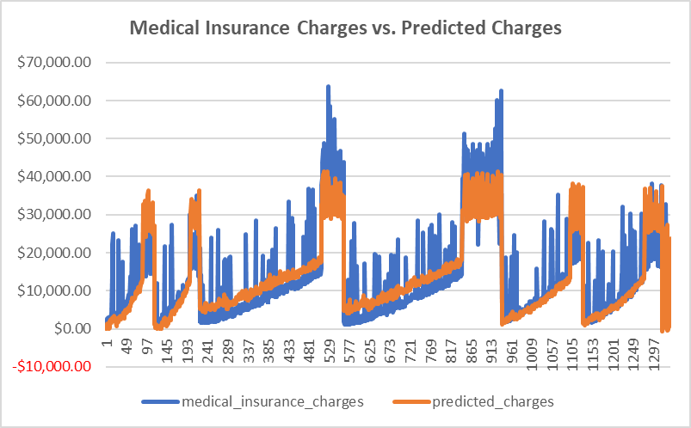
With a R Squared value of 0.75 our multiple regressive equation has a strong linear fit, with smoking, age and BMI having the strongest correlations, enabling us to create a forecast within a 75% ($-5419) range.
Note: We’ve included a sample headline for you – you can feel free to use this or modify this as you see fit

Slide 2
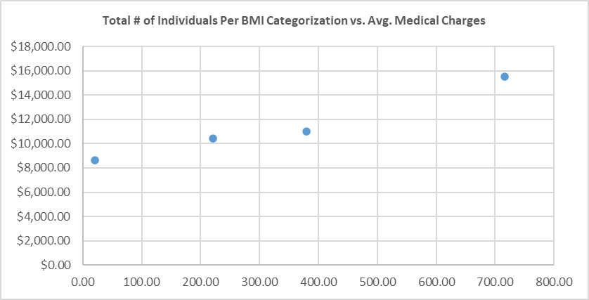
Analysis of medical insurance charges against BMI weight classification yields a weakly linear relationship, where costs increase as the BMI increases. However, we note there exists different pricing clusters, where high BMIs exist, but medical charges remain relatively low.
Note: We’ve included a sample headline for you – you can feel free to use this or modify this as you see fit

Slide 3
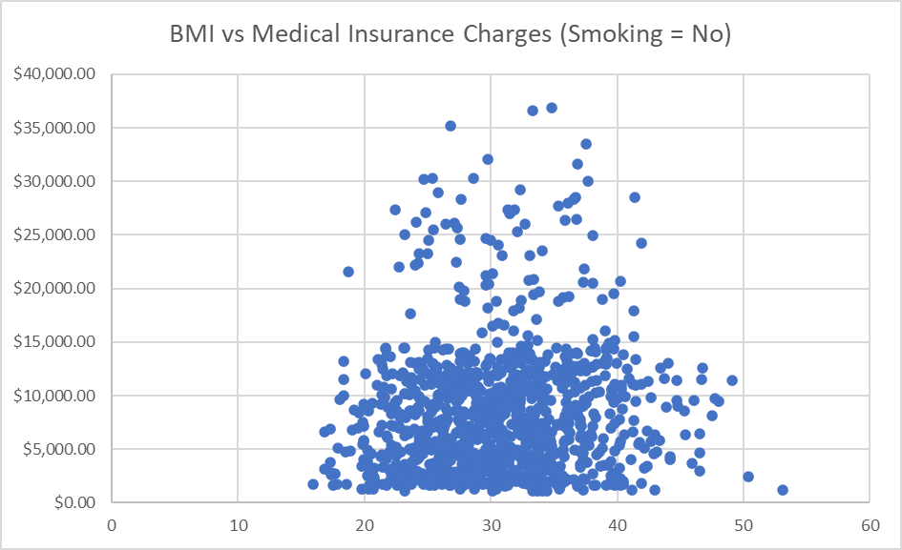
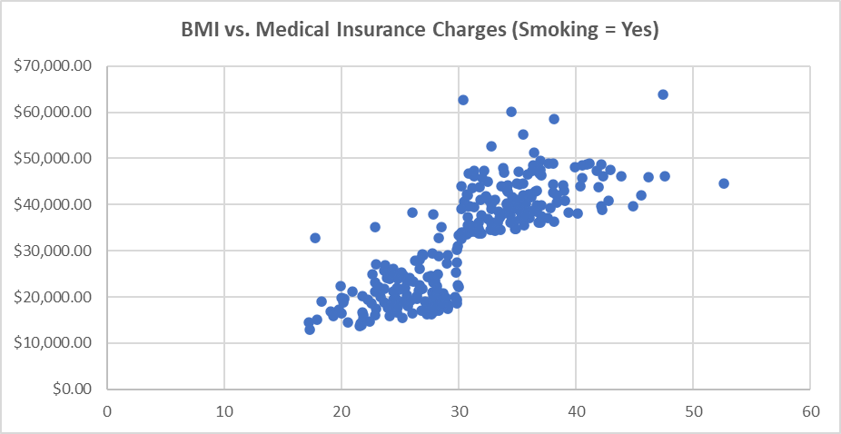
Further segmentation of the data, indicates the presence of smoking seems to be correlated towards higher medical charges, irrespective of BMI classification.
Note: We’ve included a sample headline for you – you can feel free to use this or modify this as you see fit

Slide 4
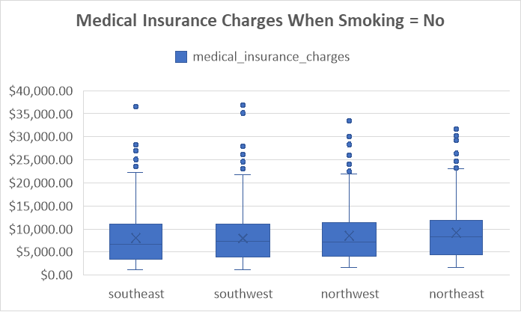
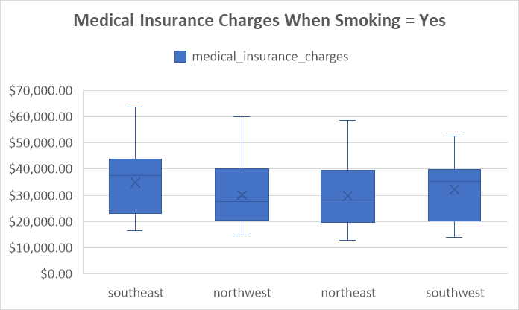
Building on our smoking theme, it is clear to see that this trend is again present as we analyse medical insurance charges by geographic segmentation. In the absence of smoking, the mean insurance charge is $8,434.27; however, with smoking, the mean charge is $32,050.23, 74% higher.
Note: We’ve included a sample headline for you – you can feel free to use this or modify this as you see fit

Slide 5
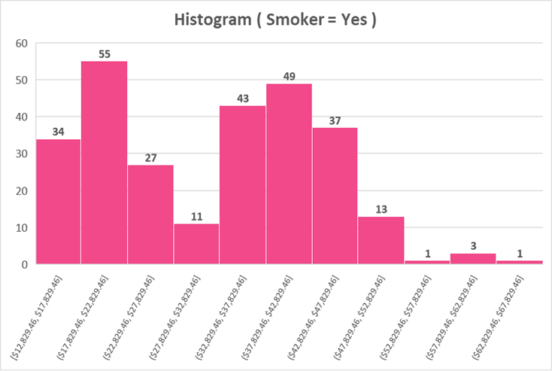
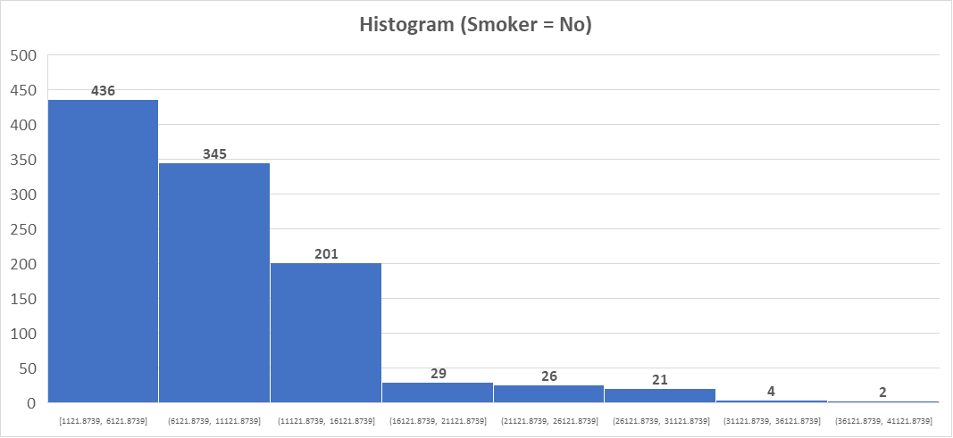
Further emphasizing the impact of smoking, the minimum medical insurance charges between those that smoke ($12.8K) and those that don’t smoke($1.1k) are as high as $11.7K (~11.4x), with the bulk of non-smokers having insurance costs less than 11K.
Note: We’ve included a sample headline for you – you can feel free to use this or modify this as you see fit

Slide 6
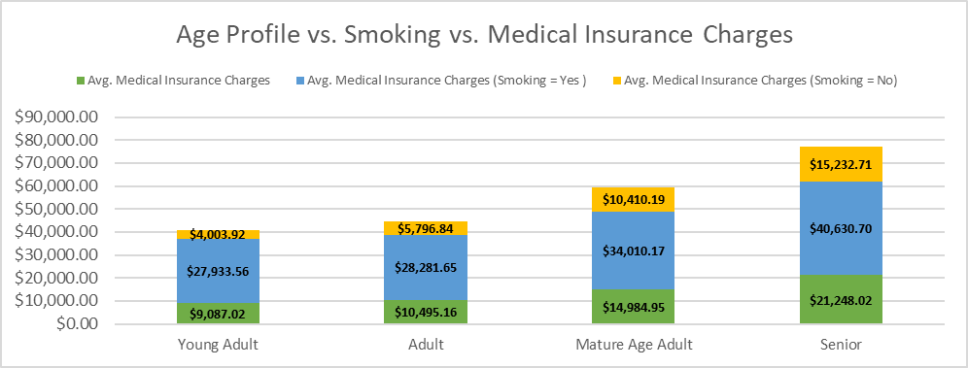
From an ageing lens, those who don’t smoke tend to have 2 – 3x lower costs, than those that do smoke. Specifically, the insurance charges for smokers increase by $19,025.21 (56%) and $19,382.67 (48%) for those between the Mature Age and Senior Age Groupings, respectively.
Note: We’ve included a sample headline for you – you can feel free to use this or modify this as you see fit

Slide 7
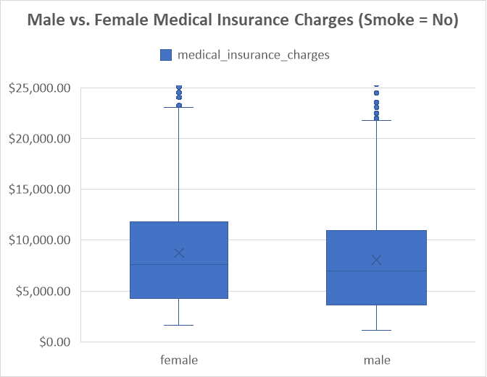
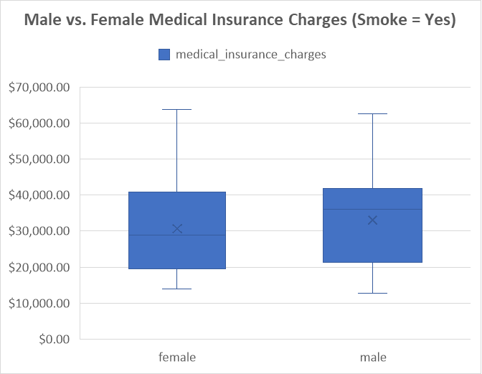
Lastly, segmentation of our data via gender, yields little difference, in the absence of smoking. However, in the presence of smoking, the average medical insurance charge increases by ~$25K (309%) for men versus females ($21K), a 250% increase.
Note: We’ve included a sample headline for you – you can feel free to use this or modify this as you see fit

